Slide 1
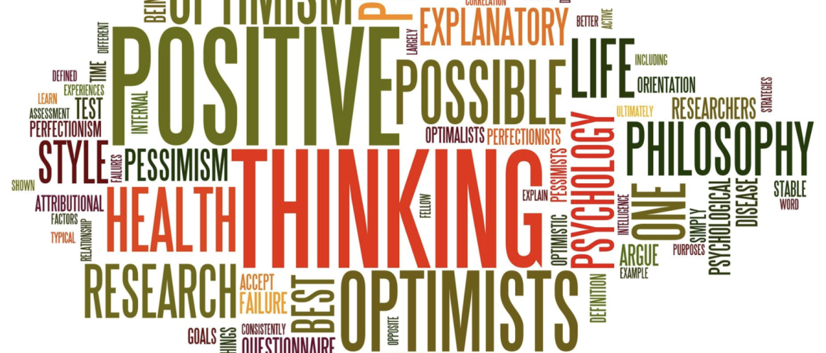
Chapter 1
What Is Positive Psychology and Why Do We Need It?

Slide 2
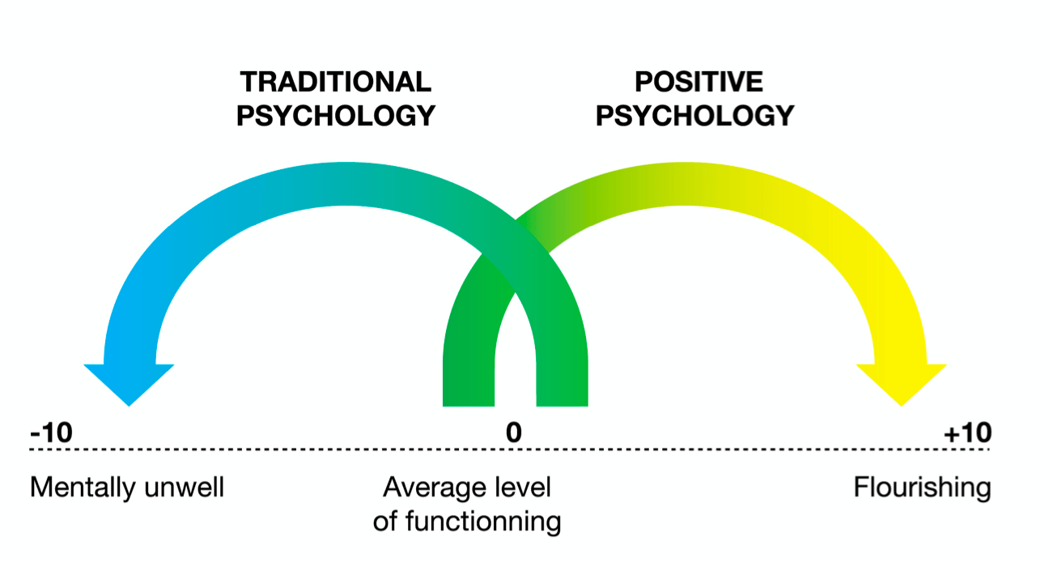
What is positive psychology?
Positive psychology: The scientific study of optimal human functioning.

Slide 3
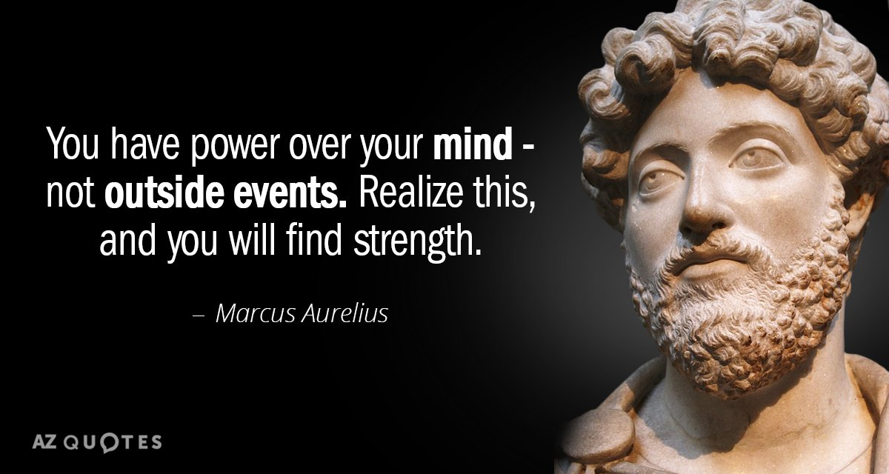
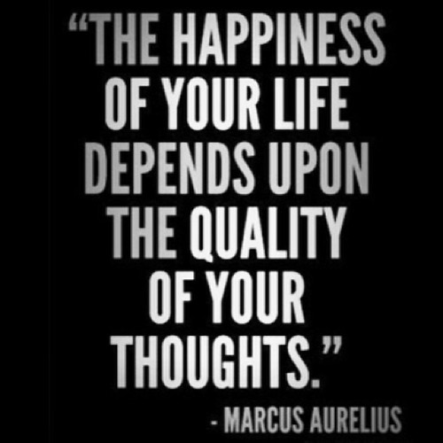
Words of Wisdom…

Slide 4
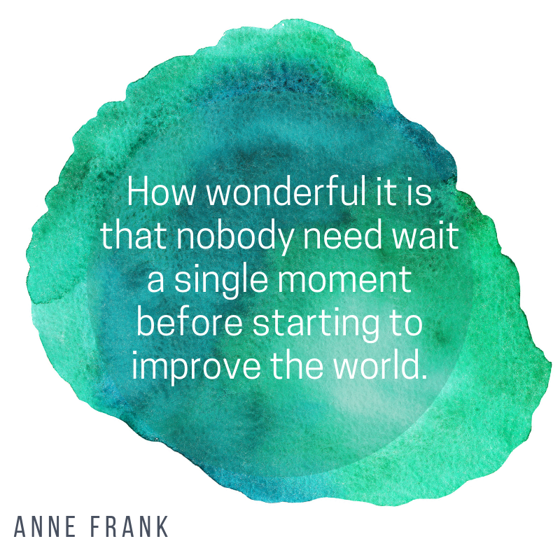

Slide 5
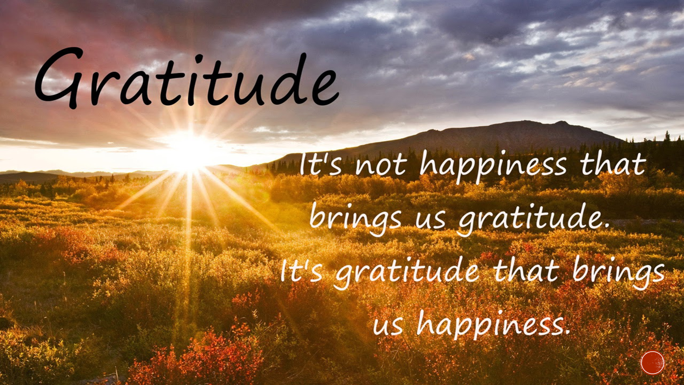

Slide 6
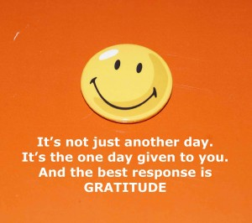
What is Gratitude?
Robert Emmons, leading scientific expert on gratitude
2 Key Components to Gratitude
  1. It’s an affirmation of goodness. We affirm that there are good things in the world, gifts and benefits we’ve received
    Does not ignore complaints, burdens or hassles
  2. Figuring out where that goodness comes from…outside of ourselves. True gratitude involves a humble dependence on others…we acknowledge that other people (or higher powers) give us many gifts to help us achieve the goodness in our lives
http://greatergood.berkeley.edu/article/item/why_gratitude_is_good

Slide 7

Journal Entry #1
“Gratitude Quiz”
https://greatergood.berkeley.edu/quizzes/take_quiz/gratitude

Slide 8
Gratitude Journaling
Be as specific as possible—specificity is key to fostering gratitude. “I’m grateful that my co-workers brought me soup when I was sick on Tuesday” will be more effective than “I’m grateful for my co-workers.”
Go for depth over breadth. Elaborating in detail about a particular person or thing for which you’re grateful carries more benefits than a superficial list of many things.
Get personal. Focusing on people to whom you are grateful has more of an impact than focusing on things for which you are grateful.
Try subtraction, not just addition. Consider what your life would be like without certain people or things. Be grateful for the negative outcomes you avoided, escaped, prevented, or turned into something positive—try not to take that good fortune for granted.

Slide 9
Gratitude Journaling
See good things as “gifts.” Thinking of the good things in your life as gifts guards against taking them for granted. Try to relish and savor the gifts you’ve received.
Savor surprises. Try to record events that were unexpected or surprising, as these tend to elicit stronger levels of gratitude.
Revise if you repeat. Writing about some of the same people and things is OK, but zero in on a different aspect in detail.
Write regularly. Whether you write daily or every other day, commit to a regular time to journal, then honor that commitment.

Slide 10
History and Scope of Positive Psychology

Slide 11
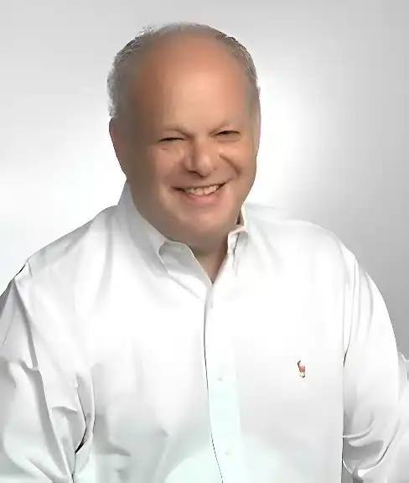
History of positive psychology
Many trace the “official” beginning of the discipline to 1996, when Martin Seligman made positive psychology the theme of his term as American Psychological Association (APA) president.
But, human strengths and what it means to lead a “good” life have been topics explored by philosophers and spiritual leaders for millennia.

Slide 12

Humanistic psychology
Humanistic psychology predated positive psychology, and included scholars like Abraham Maslow, Erich Fromm, and Carl Rogers.
Humanists were interested in optimal human functioning, but tended to use different methods:
  Humanistic psychologists used phenomenological methods, relying primarily on introspection and subjective reports.
  Positive psychologists favor experimental methods and more objective measures.
Notes:
Grateful people more likely to make positive interpretations of situations and more likely to remember events more positively.

Slide 13
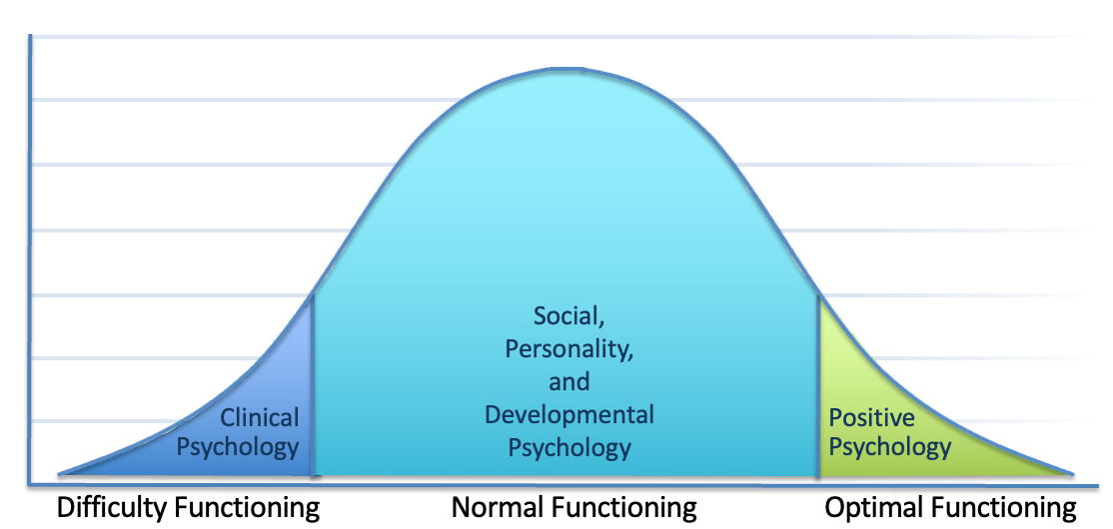
Scope of positive psychology
Psychology’s subdisciplines and the level of human functioning they typically study
Notes:
Grateful people more likely to make positive interpretations of situations and more likely to remember events more positively.

Slide 14
Positive psychology is interdisciplinary
How Researchers from Different Subdisciplines Might
Approach Positive Psychology
Sub-discipline of Psychology Possible Topics of Interest in Positive Psychology
Clinical Psychology | The role of positive psychology constructs in treating or preventing psychological dysfunction
Social Psychology | Social influences on positive experiences, affect, and behavior
Personality Psychology | The role of personality in positive experiences, affect, and behavior; positive personality traits
Developmental Psychology | The process of developing positive traits, affective and behavioral tendencies throughout the lifespan
Industrial/Organizational Psychology | The role of positive psychology constructs in organizations, companies, and industry
Neuroscience | The roles of the brain and nervous system in positive traits, experiences, affect, and behavior
Notes:
Grateful people more likely to make positive interpretations of situations and more likely to remember events more positively.

Slide 15
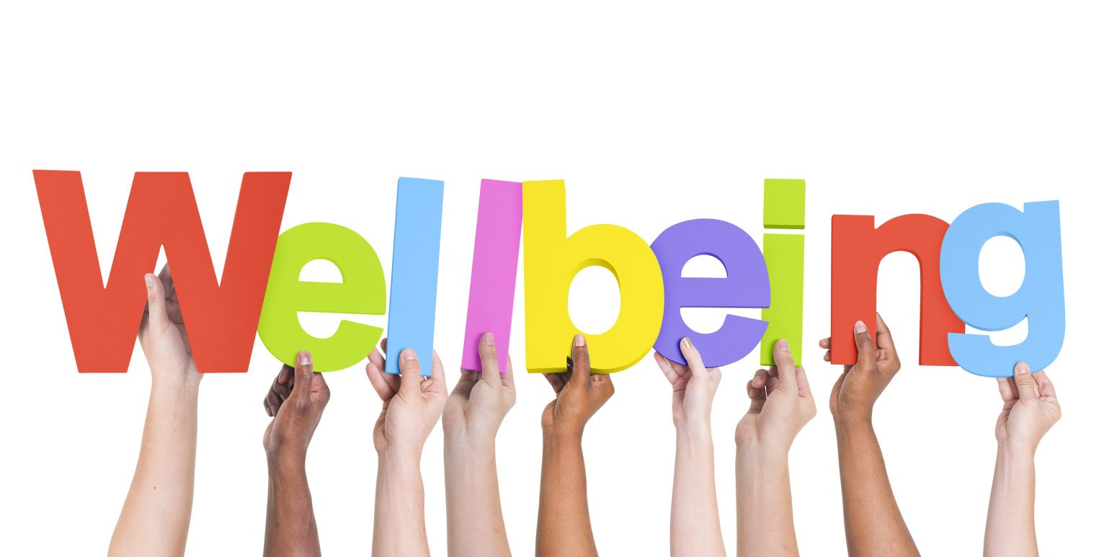
Well-being

Slide 16

Well-being
One of the major goals of positive psychology is to identify the factors that contribute to psychological well-being.
Two general types:
  Hedonic well-being: Experiencing high levels of pleasure and low levels of displeasure.
  Eudaimonic well-being: Actualizing one’s potentials or finding a sense of purpose in life.
It is possible to experience one without the other, though they are often correlated.

Slide 17

Well-Being Journal Entry #2
What Makes You Happy?

Slide 18
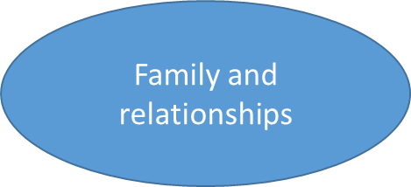
Top Things That Make Us Happy
Positive thinking
Personal freedom
Forgiveness
Religion
Giving to others/helping others
Meaningful work
Practice Gratitude
Good health

Slide 19
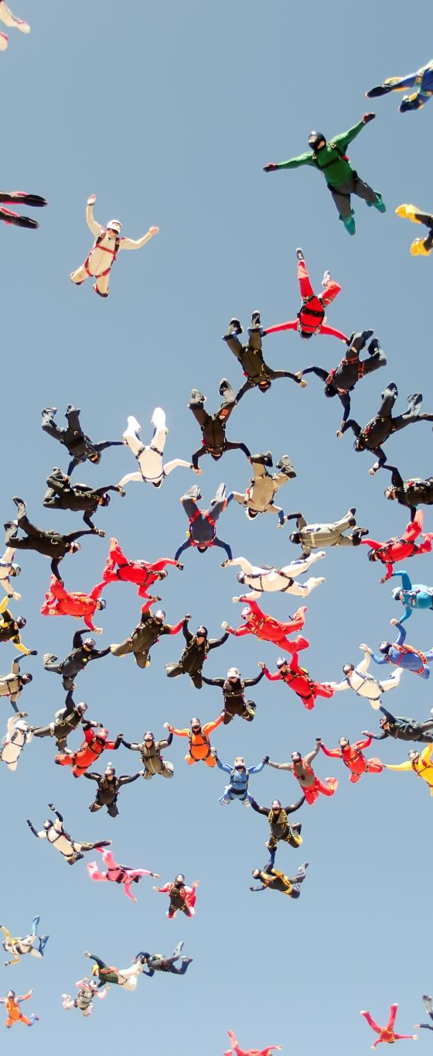
Subjective well-being
A version of hedonic well-being often used in positive psychology is subjective well-being (Diener, 2000), which states that well-being is composed of three factors:
  High levels of positive affect
  Low levels of negative affect
  High levels of life satisfaction (the cognitive evaluation of one’s life).

Slide 20

Authentic happiness
Seligman (2004) proposed a model of psychological well-being, known as authentic happiness, that attempts to bridge the hedonic and eudaimonic perspectives.
According to this model, happiness is achieved through three routes:

Slide 21
Authentic happiness
The pleasant life: Maximizing pleasurable experiences in one’s life through developing the skills to bring these about.
The good life: Orchestrating one’s life to routinely engage in activities that draw on one’s personal strengths.
The meaningful life: Pursuing goals that one believes are meaningful or allow for a connection with something larger than oneself.

Slide 22
PERMA
Later, Seligman expanded the authentic happiness model, relabeling it with the acronym PERMA to represent the five core elements theorized to contribute to a good life:
  The pleasant life, good life, and meaningful life were renamed positive emotions, engagement, and meaning.
  The first new element, relationships, acknowledges that most of us can’t bring about happiness completely on our own, but rather have a need to connect with others.
  The final new element, accomplishment, acknowledges that we often derive a sense of well-being from achieving our goals, leading to experiences of pride and fulfillment.

Slide 23
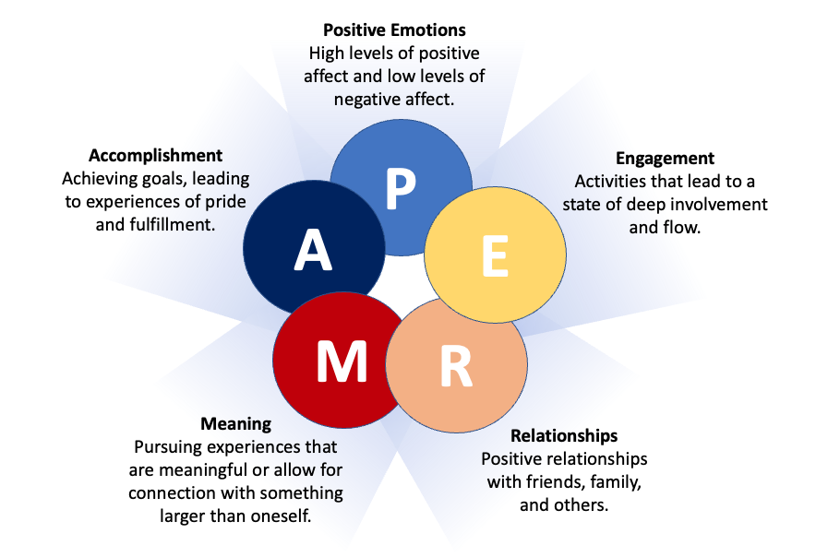
PERMA

Slide 24
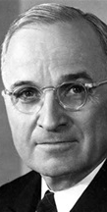
Thoughts from Seligman
Need a psychology of rising to the occasion…thought of this as a missing piece in the jigsaw puzzle of predicting human behavior
We measure behavior in absence of real-world challenges, and try to predict what a person would do
  Correlation between IQ and performance…but some people with high IQ fail, and some with lower IQ succeed life challenges
Harry Truman effect
  We have all strengths we may not
  even know about until we are challenged

Slide 25
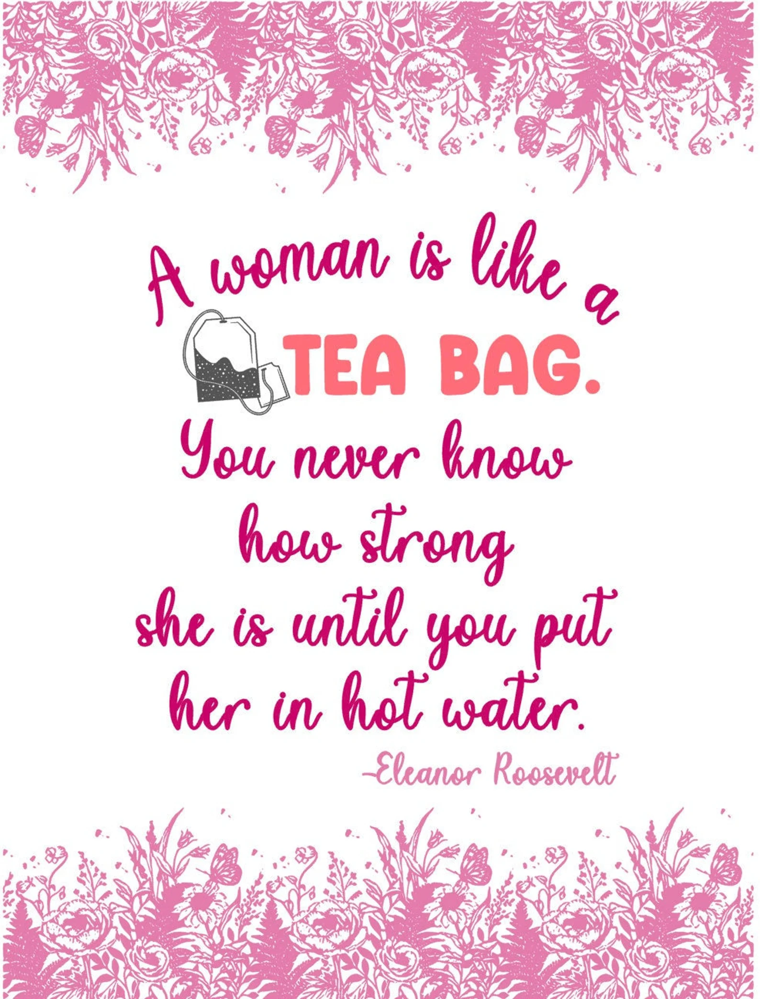

Slide 26
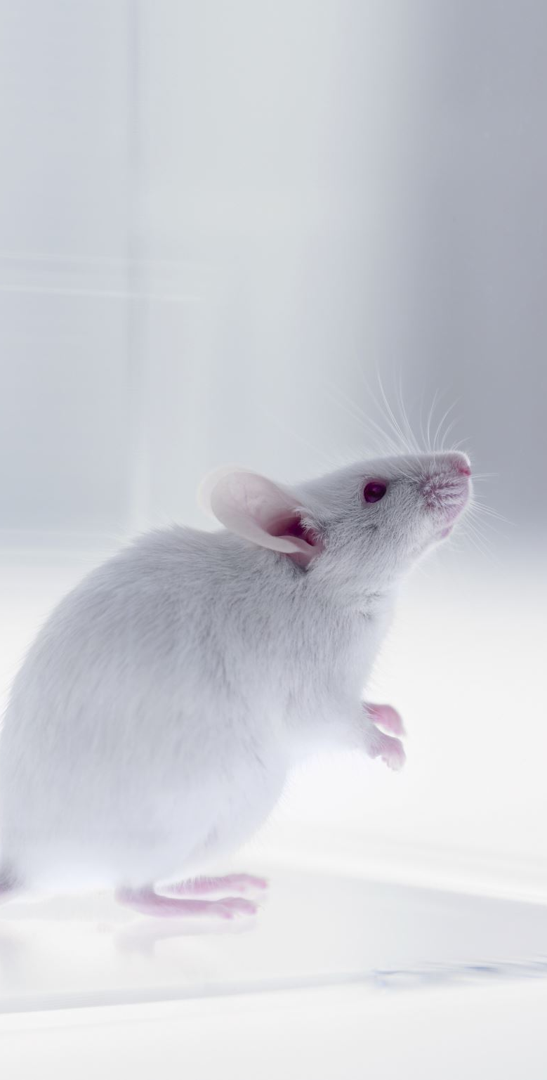
Seligman’s shift
Where did the shift from pathology to prevention come from?
Seligman known for research on learned helplessness
  BUT…not all rats and dogs became helpless, not all people became helpless with insolvable problems or inescapable noise
    1 out of 3 never gives up!
    And…1 out of 8 is helpless to begin with

Slide 27
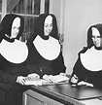
School Sisters of
Notre Dame 1932
Ceclia O’Payne Autobiographical sketch
“God started my life off well by bestowing upon me grace of inestimable value…The past year which I spent as a candidate studying at Notre Dame has been a very happy one. Now I look forward with eager joy to receiving the Holy Habit of Our Lady and to a life of union with Love Divine.”

Slide 28
School Sisters of
Notre Dame 1932
Marguerite Donnelly Autobiographical sketch
“I was born on September 26, 1909, the eldest of seven children, five girls and two boys…My candidate year was spent in the motherhouse, teaching chemistry and second year Latin at Notre Dame Institute. With God’s grace, I intend to do my best for our Order, for the spread of religion and for my personal sanctification.”

Slide 29
School Sisters of
Notre Dame 1932
Sketches were rated in the amount of positive feeling
  Most cheerful quarter: 90% alive at age 85, 54% at age 94
  Least cheerful quarter: 34% alive at age 85, 11% at age 94
Cecilia O’Payne (lived over 98 years)
Marguerite Donnelly (died at 59)

Slide 30

Well-Being Journal Entry #3
Your Philosophy for a Happy Life –Watch the TED talk titled “My philosophy for a happy life” by Sam Berns (https://www.ted.com/talks/sam_berns_my_philosophy_for_a_happy_life). After watching, write a paragraph on what you would consider your personal philosophy for a happy life.

Slide 31
Culture and positive psychology
Because of a Western cultural bias in the field of psychology in general, most empirical research within positive psychology concerns Western views of well-being.
Of course, philosophical and spiritual thinking about well-being hasn’t been restricted to Western culture. For millennia, Eastern philosophers and spiritual leaders have addressed factors believed to contribute to well-being.
In addition to this Western cultural bias, research too often includes biased samples that underrepresent persons of color, non-Christian religious views, individuals from the LGBTQ+ community, and other important groups. Although researchers today are increasingly honoring more diverse cultural perspectives in their work, there is still much work to be done.

Slide 32
Culture and positive psychology
Eastern worldviews are not all the same, of course. Spiritual and philosophic traditions abound, including schools of Buddhism, Confucianism, Hinduism, Shintoism, Taoism, and others.
These varied approaches to life, however, share certain ideas about well-being that broadly contrast with Western views:
Eastern Culture | Western Culture
self-transcendence | self-enhancement
harmony | mastery
contentment | satisfaction
valuing suffering | avoiding suffering

Slide 33
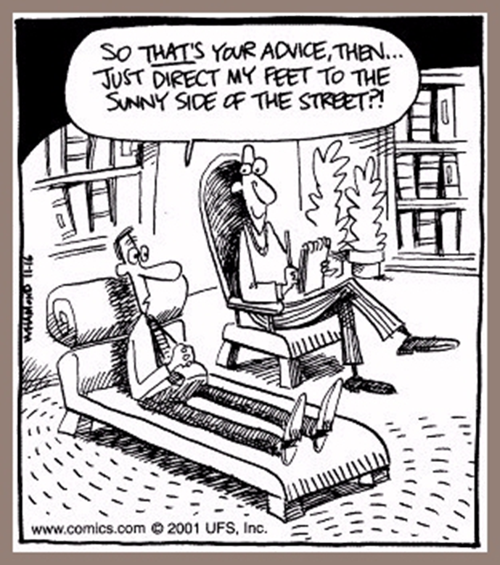

Slide 34
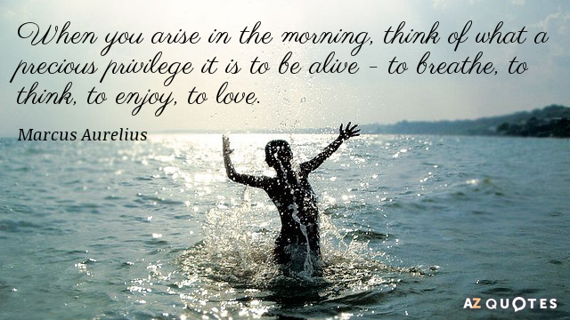
Words of Wisdom…

